Slide 1
jQuery - API (Day 3)
Viktoras Lava www.viktoraslava.lt

Slide 2
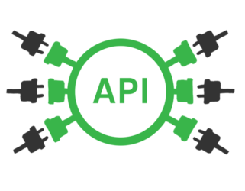
What is API?
API stands for application programming interface.
Like graphical user interface makes it easier for people to use programs, API makes it easier for developers to use certain technologies when building applications.
API usually have a well-written documentation.

Slide 3
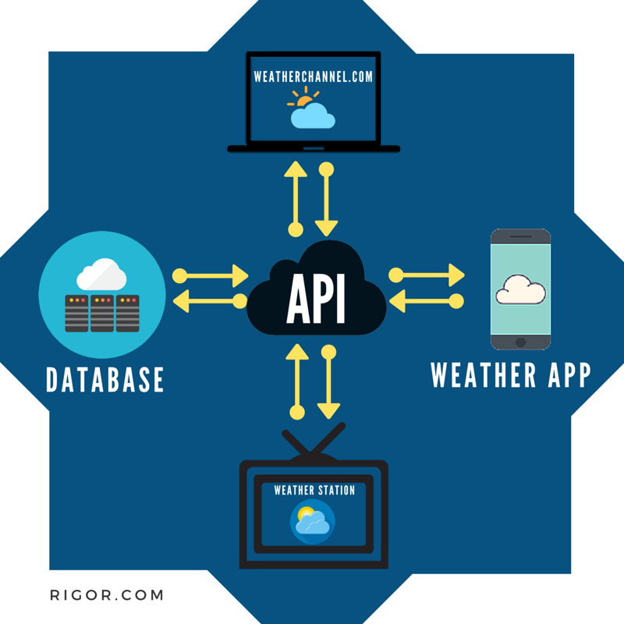
What problem do APIs solve?
APIs are built as an attempt to free the data from web interfaces
APIs define the rules that programmers must follow in order to interact with a programming language, a software library, or any other software tool.

Slide 4
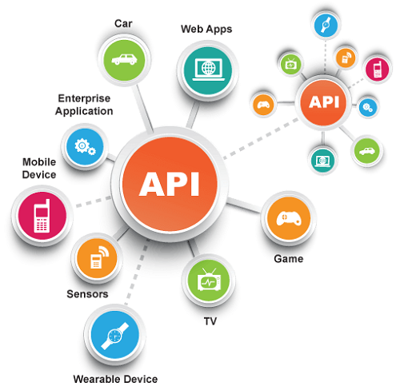
Popular API providers
Google Maps
Youtube
Twitter
Facebook
Google API explorer
API landscape
API explorer

Slide 5
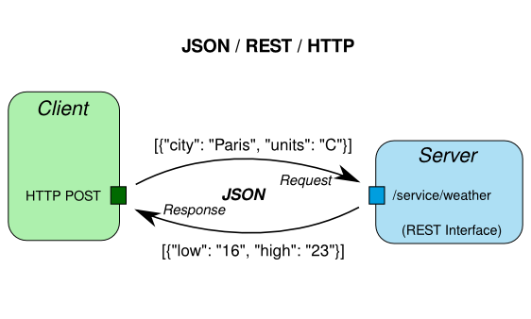
How APIs work?
APIs usually communicate between each other through HTTP protocol.
Simple API process:
Client sends POST/GET data as JSON or XML to the server’s API endpoint “/service/weather”
Server processes the data and sends it back as JSON or XML response

Slide 6
Questions?

